Slide 1

IRONHACK
LinkedIn: If you’re not IN, you’re OUT.
Notes:
Hello Ironhacker, in this workshop we’re going to share some of the best insights we’ve gathered throughout the years helping other Ironhackers land jobs in the world of tech. In this particular one, we’re going to talk about the fundamentals of the LinkedIn platform, why it’s absolutely essential that you’re on it to rock it, and how to have a profile that showcases your recently acquired skills, but also your background and motivation to attract recruiters.
So, are you ready to learn everything about LinkedIn? If yes - let’s do this!

Slide 2
WHY LINKEDIN?
Why do I have to be on there?
IRONHACK 2023. ALL RIGHTS RESERVED.
Notes:
Let’s start by understanding why do we have to be on LinkedIn to start with. Because once you understand that, it will all start to make sense to you.

Slide 3

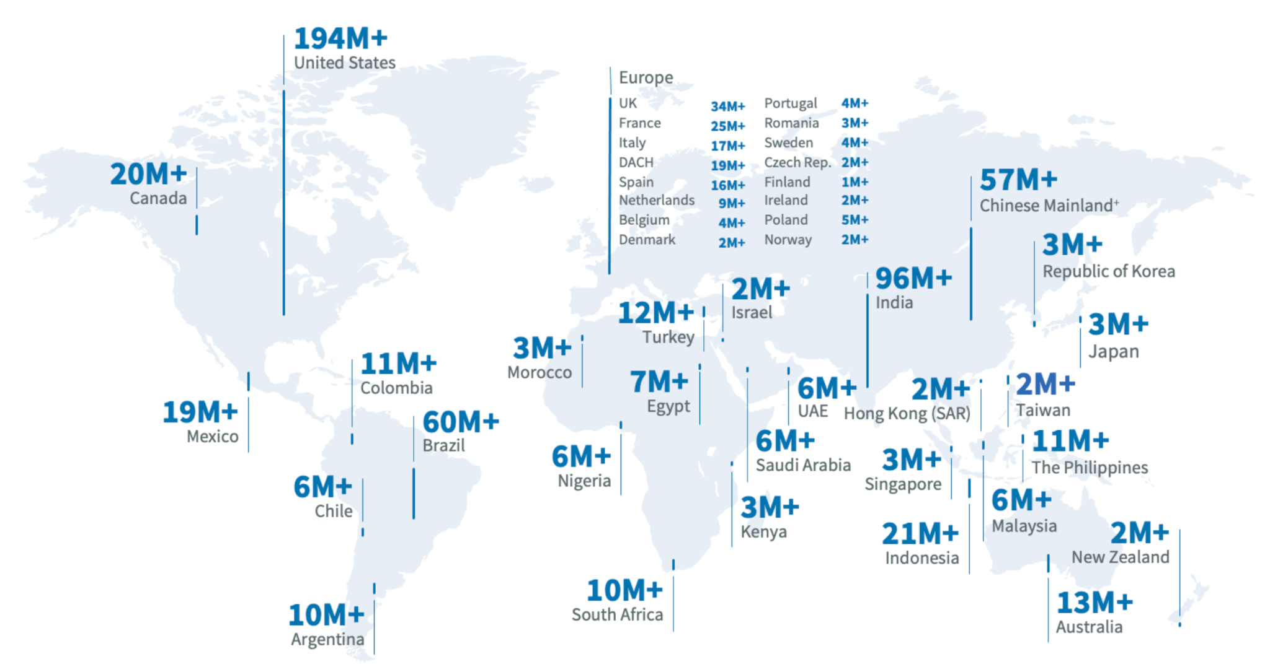
LinkedIn is today’s biggest online
social, professional network
875M users worldwide
58 M companies listed
14M+ job openings
87% of recruiters use LinkedIn
8 people are hired every second on LinkedIn
Notes:
Let’s talk facts and figures. LinkedIn has become the go-to platform for job seekers in the industry. It literally has no competition in place and it’s growing every single day. With over 875 million users worldwide and 58 million companies listed, LinkedIn is the vastest network of professionals and job opportunities that you can find and if you spend time understanding how it works and how to make the most of it, it will have a significant impact in your career growth, I can assure you that. I myself, worked at LinkedIn for a few years and have been hired through the platform in numerous occasions - so in today's competitive job market, having a strong presence there can increase your visibility to potential employers and enable you to connect with other professionals in your field. But we’ll talk more about that in just a second.
What's more, 87% of recruiters use LinkedIn to find candidates for job openings!!!!! This makes it crucial for you to have a well-crafted LinkedIn profile that showcases your skills, experience, and achievements. Also, there’s over 14 million job openings posted at any given time, so LinkedIn is an excellent tool for you to find opportunities and a myriad of companies of interest in the tech industry. In fact, every second, eight people are hired through LinkedIn!
But, aside from looking up jobs - what else can I do there? You might be asking yourself… well, let me answer that!

Slide 4
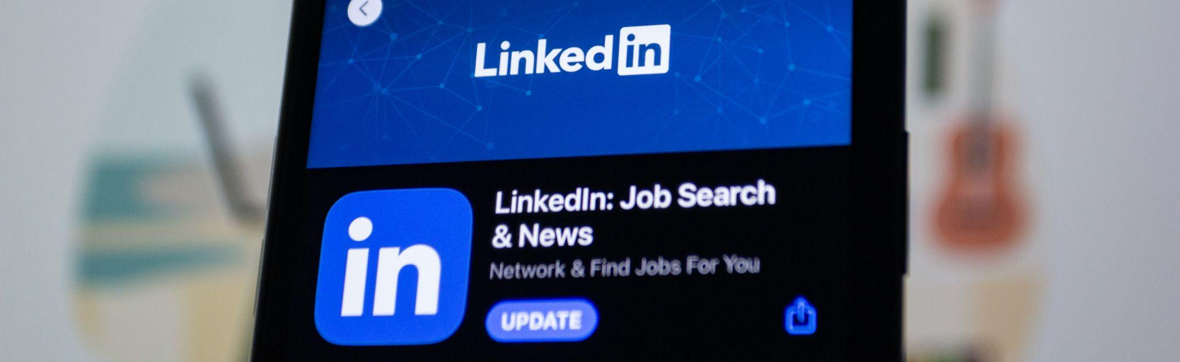
More about IT Recruiters
What do people do on LinkedIn?
Jobs and career growth
Read professional content to learn and grow in their field
Grow their network of like-minded professionals
Learn new skills
Find on sight and online industry events
Join professional groups/communities
Write blog posts, share articles
Attract and recruit talent
Etc.
Notes:
When LinkedIn started nearly 20 years ago, it started as an online job board but now we’re talking about a new ball game here. Today, it is a professional ecosystem in which users come to consume professional content to stay up to date with industry trends. In fact, it should be a regular source of information for you to keep learning and growing as a junior developer, analyst or designer. But not only to source information, but to share it! We live in a digital world and you can contribute with content too (about your projects by writing blog articles, sharing short videos, etc.) and drive profile visitors - but we’ll talk more about that in another more advanced chapter. Another way in which you can use LinkedIn is to learn new skills through LinkedIn Learning - a service the platform offers to help users upskill on a myriad of topics, both technical and non-technical. Check out LinkedIn courses and certificates - you’ll see that the offer is ever growing and that you can add badges to your profile, making it look even more appealing. Other reasons people are on LinkedIn is because you will find a myriad of professional communities and events, both on site and online. Because the truth is that LinkedIn is THE place for modern networking with professionals in pretty much any industry - and definitely in tech. In fact, once you have your profile set up - you should be spending the majority of your time on LinkedIn growing your network - following Ironhackers, industry professionals, recruiters, and following companies and communities of interest. But don’t worry about that now. The point is that your network will be a key asset in your success landing your first gig in tech. Obviously we’ve covered what individual users like you come to do on LinkedIn, but don’t forget that from an organisational perspectives - LinkedIn is used to market products, services and to attract and recruit talent worldwide. Convinced yet? If you’re not IN, you’re OUT!

Slide 5
THE LINKEDIN ALGORITHM
What’s the deal?
IRONHACK 2023. ALL RIGHTS RESERVED.
Notes:
Understanding how the LinkedIn algorithm works and how to optimize your profile and content can significantly impact your job search on the platform. By staying up-to-date with the latest trends and best practices, you can increase your visibility to potential employers and find the right job opportunity to grow your career. Even though we will deep dive into it in another more advanced chapter of LinkedIn - let’s touch on a few important aspects - but we encourage you to research a bit more if you’re curious about all the ins and outs of it.

Slide 6
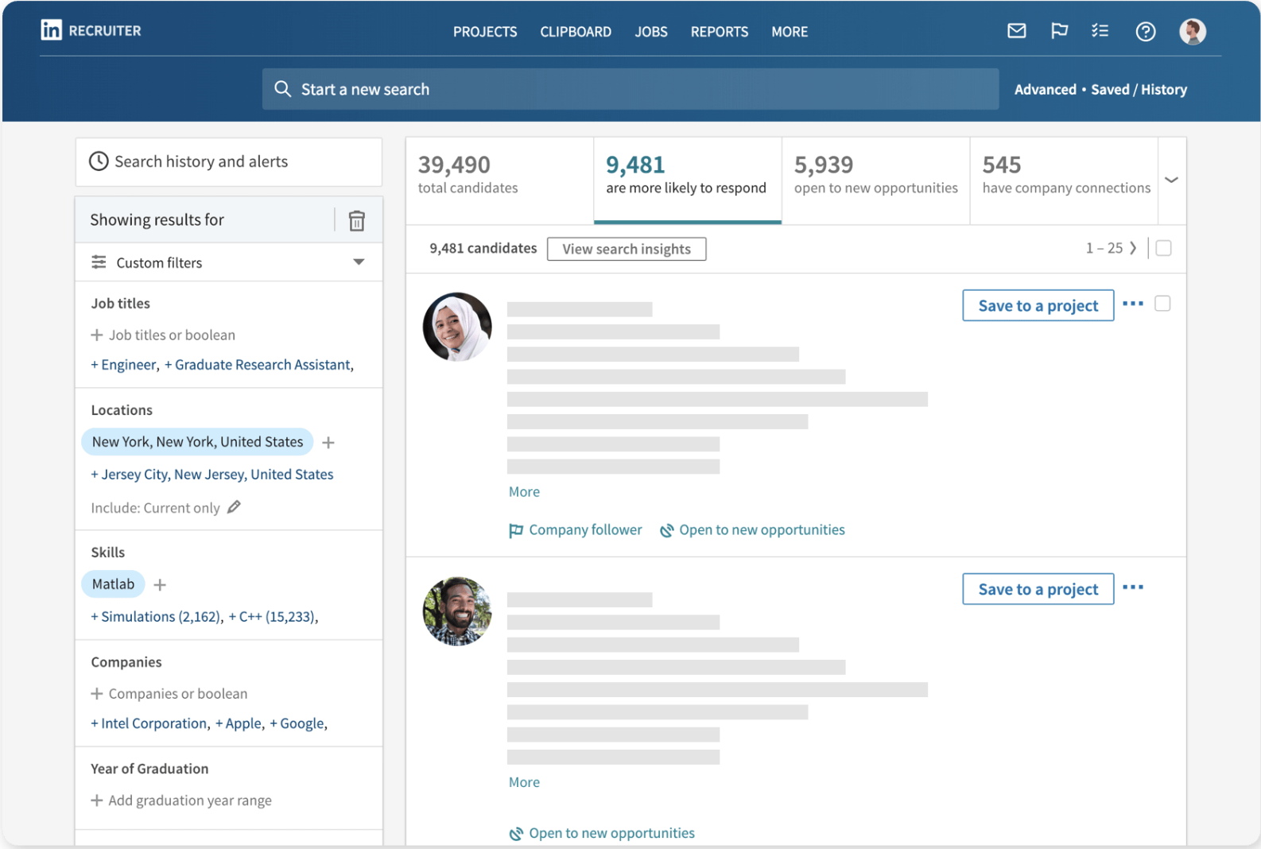
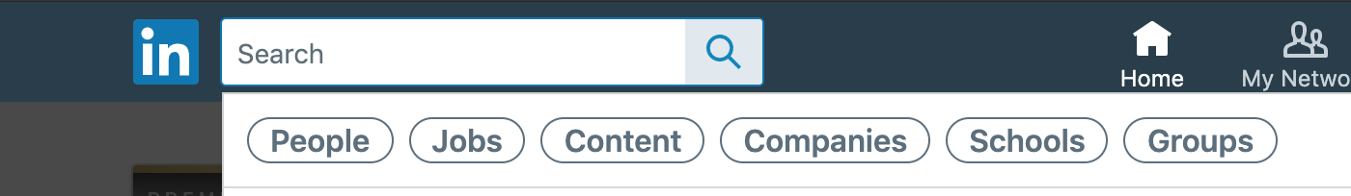
Keywords rule
Your profile needs to contain keywords in at least 5 sections of your profile (Job Title, About Me, Experience, Education, Skills)
The better you can describe what you do and what you want to do, the better LinkedIn can show you suitable jobs, companies, people or articles - and recruiters find you!
Type in any keyword on the LinkedIn search bar to find people, jobs, events, companies, etc.
Notes:
LinkedIn's algorithm is a complex system that determines what content and profiles to display on your feed and in search results. And the same way it works like that for you as a single user, it does too for recruiters! In fact, recruiters have a special subscription with specific features that you cannot see. You can see an exampleon the current slide. Basically, it allows them to filter candidates and scan through their profiles to get a short list of ideal candidates. They can filter by location, years of experience, skills and so on. Then, once they interview candidates they have other special features such as note taking, etc. And just like in any other search engine tool, the use of keywords is essential. So a recruiter will enter specific criteria for the job vacancy they’re trying to fill and YOU need to make sure that your profile has these keywords to show up on that list. But hold on there - we’ll go deeper into this in the coming slides.
On the one hand the algorithm is extremely useful for you to be found by employers, but on the other hand, it is useful for you as a user! The LinkedIn search bar works just like any other search engine like Google - so type in any keywords of interest and filters to find senior developers, designers, recruiters, job opportunities in your city, interesting industry events, companies, startups, content and much more!
Long story short: We are going to show you what relevant keywords to add and where to make sure you’re in recruiters’ radars. And not only that, but how to build a strong presence on LinkedIn, so that you can boost your visibility and make the most of this ever growing professional community.

Slide 7
INVESTING IN YOUR FUTURE, TODAY
Main tips to stay on the right track
IRONHACK 2023. ALL RIGHTS RESERVED.
Notes:
As a recap - LinkedIn has become so important in the professional world that we have to invest in it day by day - to make sure it brings fruitful results to our personal and professional growth. So simply having your profile on LinkedIn, checking job offers and applying is less than half of the job.
If you really, really want to benefit from all the wonders of this platform and see significant results you need to invest time on it, not just spend it like you may do on Instagram or Tiktok.
Let us summarise a few super quick tips to make sure you’re on the right track.

Slide 8

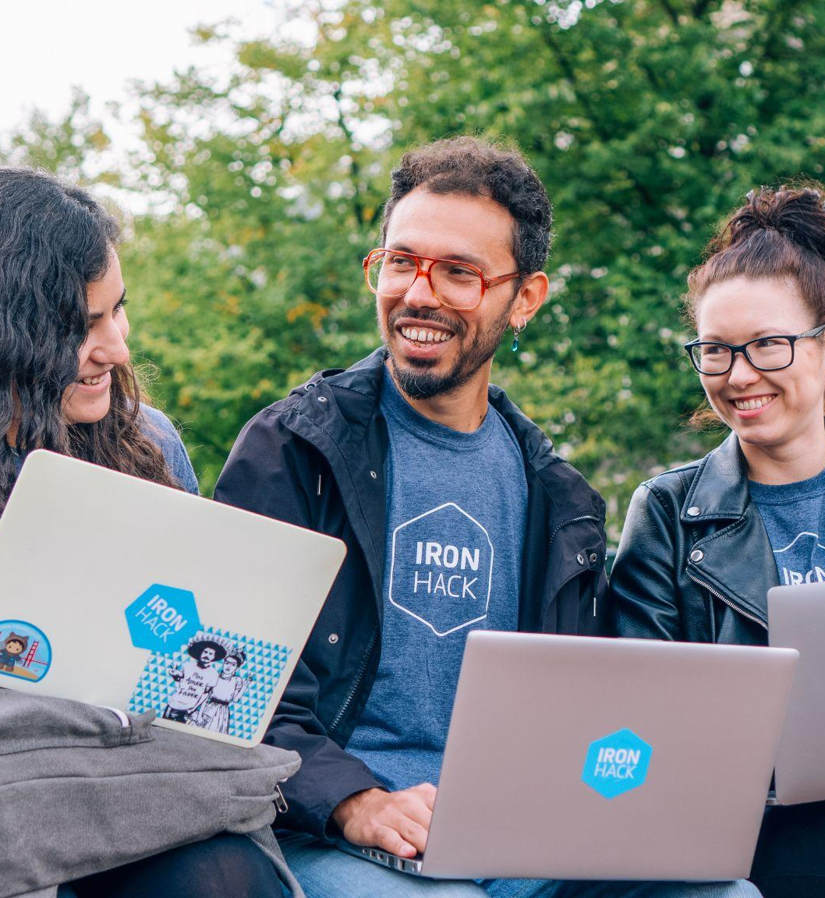

Wanna stay ? Then make sure to stay active!
Follow all tips and advice on these slides
Take time to build a nice, elaborated profile that showcases your talent, career goals and personality
Make use of LinkedIn by engaging with the ecosystem
Make it a habit to go online
Post regularly
Like, comment, share content
Follow companies of interest
Networking - a muscle to be trained daily!
Notes:
First and most important piece of advice: It's essential that you have an active role on LinkedIn, that you participate in conversations, engage with and add value to the community. Otherwise, chances are that you will be unnoticed among the millions of other users.
Take the time to build a nice, elaborated profile that showcases your talent, career goals, interests and personality. Remember to follow all the tips and advice provided in these slides to make your profile stand out from the crowd.
Make use of LinkedIn by engaging with the everything that’s happening there. Make it a habit to go online, post regularly about your projects, newly acquired skills or other topics of interest, - like, comment, and share content that is relevant to you. By doing so, you will increase your visibility on the platform and attract potential employers' attention, and remember to follow companies or industry influencers to stay up-to-date with their latest job openings or news.
Finally, networking is essential to any successful job seeker. Connect with fellow Ironhackers and industry professionals on LinkedIn, attend virtual or on site events, and join groups relevant to your career interests. Remember, all you have to do is use the navigation bar and type whatever keyword you want. LinkedIn requires some work if you want it to provide you with helpful content and meaningful connections to slowly get your foot in the door.

Slide 9
THE PROFILE
The header, headline and your URL
IRONHACK 2023. ALL RIGHTS RESERVED.
Notes:
Welcome back Ironhacker! Now it’s time to scan through all the key sections of the LinkedIn profile together and share tips on how to complete these with your personal information. But remember, we will provide general guidelines and later feedback, but it is you who will have to put the time and work to write your story, describe your past experiences and highlight your skills and unique talents. So let’s start with the upper part of the profile: your headline and url!

Slide 10

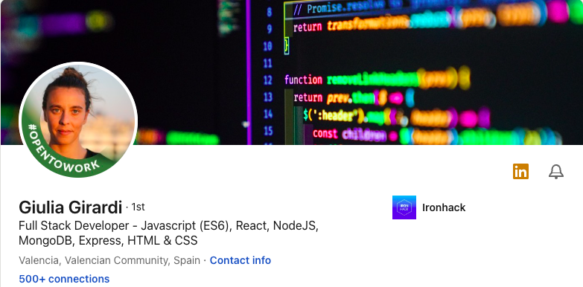
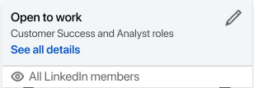
Members with a profile picture receive up to 21x more views and 9x more connection requests
Look to the camera
Use a neutral background
Look smiley and professional
Make sure your face is at the focus
#OpenToWork
Notes:
Your LinkedIn profile is your digital business card and the first impression you make on potential employers and professional connections. To make the most out of your LinkedIn presence, it's crucial to have a polished and professional profile that showcases your skills, experience, and personality. As you can see, you can personalize your profile by adding a background image to make it look more professional and personal. You can either create your own, or look up for template background images in places such as canva.com.
Your LinkedIn profile picture is one of the most crucial elements of your profile. According to LinkedIn, members with a profile picture receive up to 21x more views and 9x more connection requests than those without one. Here are some tips to ensure your profile picture is making a positive impact:
First, look directly at the camera. This helps you make eye contact and establishes a connection with the viewer.
Next, use a neutral background that doesn't distract from your face. A plain or blurred background works best.
Make sure you look smiley and professional in your picture. Dress appropriately for your industry and avoid any distracting accessories or clothing.
Your face should take up the majority of the frame, so avoid using a tiny or faraway image.
Finally, consider adding the #OpenToWork frame to your profile picture if you're currently job hunting. This lets potential employers know that you're actively seeking opportunities.
Let’s move on to another very important section on the top of your profile.

Slide 11

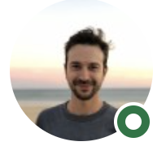
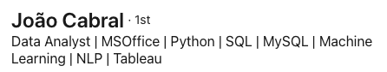
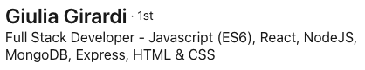
Your headline
After our name, it’s the first personalized section that LinkedIn users see! It is also one of the sections that heavily influences our keyword ranking.
Example WEB: Junior Full Stack Developer - Javascript (ES6), MongoDB, Express, React, NodeJS, HTML & CSS
Example UX/UI Design: Junior UX/UI Designer - Sketch, Invision, Figma, Adobe Creative Suite, HTML & CSS
Example Data Analytics: Data Analyst - Python, SQL, Tableau, Machine Learning
Example Cybersecurity: Cybersecurity Analyst| Specialist - Linux, Splunk, IBM QRadar, FileAlyzer, APKtool, Yaazhini, Wireshark.
Notes:
The LinkedIn headline is one of the most important sections on your profile. It's located right under your name and it's the first personalized section that LinkedIn users see when they come across your profile.
Not only is it the first thing people see, but it's also one of the sections that heavily influences your keyword ranking on LinkedIn. That means the words you choose to include in your headline can impact how often your profile appears in search results when someone looks for professionals with your skills or experience.
Your headline should be a brief, compelling statement that summarizes who you are, what you do, and what makes you unique. It can include your current job title (which by the time you graduate it will be either Junior Web Developer, Data or Cybersecurity Analyst or UXUI Designer), and areas of expertise, mainly your tech skills. You’re welcome to add a few more keywords that describe areas of expertise, as well as any relevant certifications or awards.
Think of your headline as a way to quickly grab the attention of recruiters and potential connections, and entice them to read more about you. You can pause the video right here and take a look at some examples of headlines by field of study. Then, add your personal touch to it and remember to always keep an agile mindset: plan, execute, analyse and iterate!

Slide 12
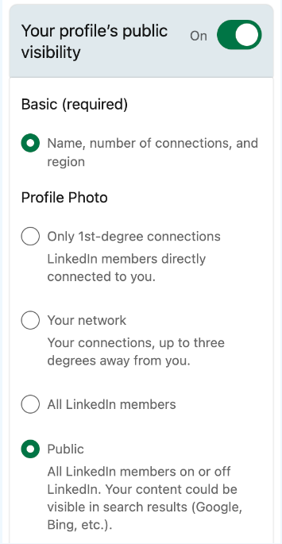
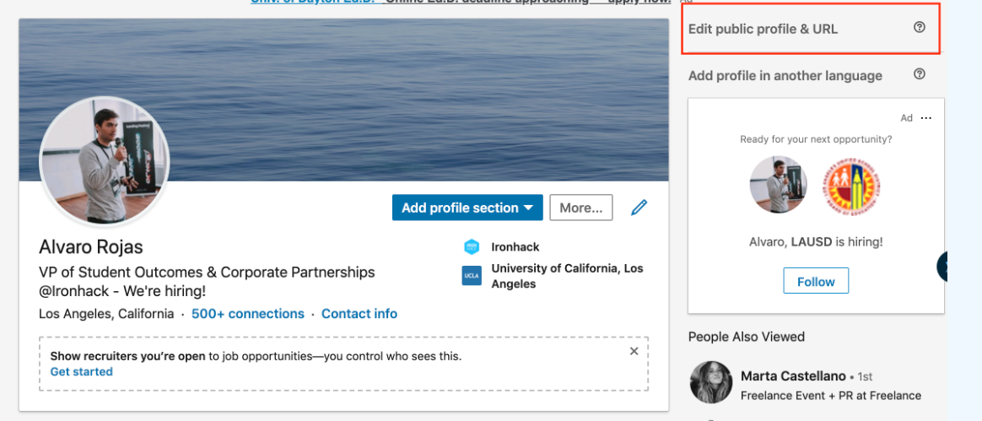
Customize your URL!
Look to the camera
Use a neutral background
Look smiley and professional
Make sure your face is at the focus
#OpenToWork
Notes:
Let’s talk about the URL and why it can be helpful for you to edit and customise it. A custom LinkedIn URL looks more professional and polished than a random string of numbers and letters. It's also easier to share with others.
It's easier to find you: When you use a custom URL that includes your name or your industry, it's easier for people to find you in search results. Something like www.linkedin.com/clarapinillos-careercoaching or JuliaGiuliardi-juniorreact
In fact, it can help with SEO, meaning your search engine optimization. By including keywords in your URL, you can increase the chances that your profile will show up in search results when someone searches for those terms.
With these small but important tips, you can start polishing your LinkedIn profile. So feel free to stop right here and get to it before you move on to the next section.

Slide 13
THE ABOUT ME SECTION
Your story told by yourself
IRONHACK 2023. ALL RIGHTS RESERVED.
Notes:
Your LinkedIn 'About Me' section is the heart and soul of your profile. It's the place where you can showcase your personality, your professional passions, and your personal values. In this section, you have the chance to make a connection with anyone who visits your profile, whether it's a recruiter, a potential employer, or a fellow professional in your field. So, it's crucial that you take the time to craft a compelling, authentic, and concise 'About Me' summary that showcases your unique strengths and aspirations. Let's take a closer look at what makes a standout 'About Me' section on LinkedIn

Slide 14
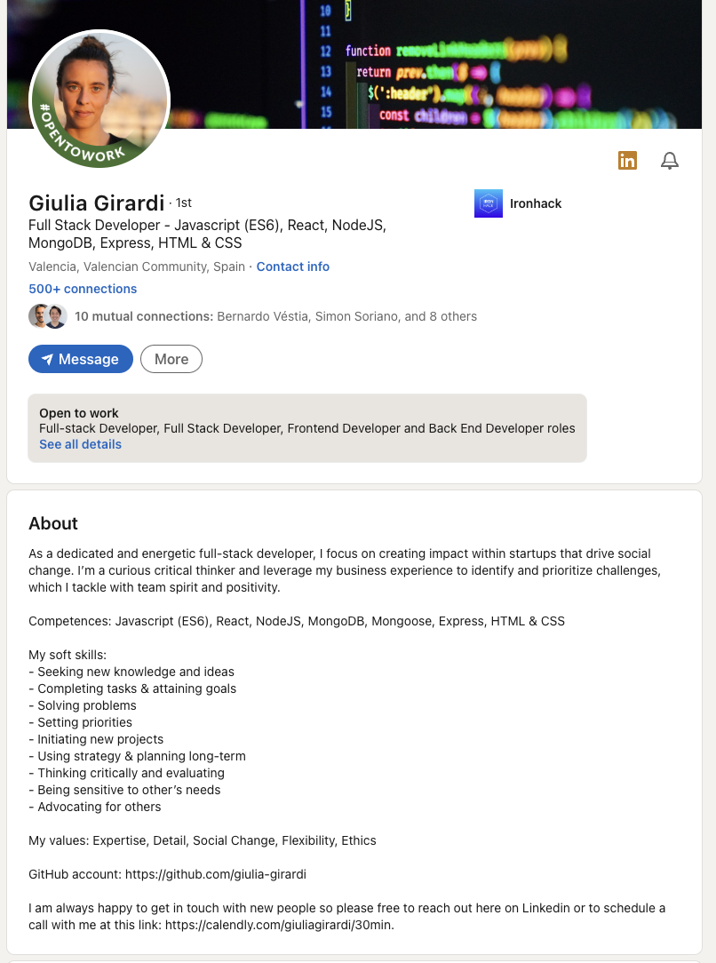
A unique chance to tell your story in your own words
You can be you! Don’t talk in 3rd person 😱
Know your audience
Think about what you want to transmit
Make it short and sweet! Use bullet points?
Add keywords (industry-related & personal)
Be clear! What role are you looking for?
How would you like to be reached out?
Notes:
One thing to remember is that your LinkedIn About Me section will be a continuous WiP - so don’t worry if it’s not perfect from the beginning. Every now and then you can check it again and adjust whatever you want and a very great piece of advice is to check other people’s profiles, especially those of fellow Ironhackers to find inspiration to write your own! You can be yourself, and in fact this is one of my favourite sections of the LinkedIn profile because you can showcase your personality through your writing. And I know it’s not easy, but you will get there if you follow our tips and always ask for feedback. So, first of all - avoid talking in the third person as it can come across as impersonal. Be you, yourself and talk to your audience (recruiters, potential employers and fellow industry colleagues) however you want - being clear and professional - but being authentic.
When writing your about me section, keep it short and sweet. Remember we talked about how recruiters are really busy people on the CV workshop of Careerhack - so don’t get caught up into a lot of unnecessary details. Feel free to use bullet points actually, it can help make it easy to read. Now, in the previous section we talked about the LinkedIn algorithm and profile optimisation right? I explained that there were certain sections in which keywords would be absolutely essential. Well, the About Me section is one of them. Make sure you add the keywords related to your industry and personal strengths. This means, repeating your tech skills acquired during the bootcamp, even if you added them in your headline and will do so in other additional sections of the profile. It’s the consistency and the repetition that will help boost your profile at the beginning of your career, given that you have no professional background experience. So remember, add your industry keywords to show up in relevant searches.
And lastly, be clear about the role you are seeking and how you want to be reached out. Don't forget to mention your personal and professional values, as well as your career goals. This will help recruiters and potential connections understand your aspirations and make relevant introductions. On the next slide, I’ll be a bit more specific about what you can write.

Slide 15
Try to answer these questions
WHO AM I?
Your job title, i.e. Junior Frontend, Junior Data/Cyber Analyst, UXUI Designer, etc.
WHAT CAN I DO?
Skill highlights → tech skills + other transferable personal & professional skills from your past experience (check offer)
WHAT DO I BRING TO THE TABLE
What makes YOU unique
Your motivation?
WHAT AM I LOOKING FOR? WHAT MOTIVATES YOU?
Why did you change gears into tech?
What position are you interested in?
WHERE CAN YOU CONTACT ME?
Add your preferred contact information such as your email address.
Notes:
So, start by introducing yourself. Who are you, and what do you do? What makes you unique?
Highlight some of your key skills and achievements from previous experiences. What are you particularly proud of, and what can you bring to the table or to a potential new employer?
Since you are a Career Changer, most likely, take advantage and share your story! What triggered your decision to change careers and do the Ironhack bootcamp? And what have you learned along the way?
Share what you're most passionate about in your field, whether that's data analysis, web development, UX/UI design, or cybersecurity.
Discuss your personal and professional values, briefly of course. And try to answer - what motivates you, and what you stand for.
Share your career goals. What kind of role or company are you interested in joining, and what do you hope to achieve in your career?
And finally, let people know how they can get in touch with you. Provide your email address so that potential employers and colleagues can reach out to you directly.
If it helps, here are some questions that you can try to answer. It’s similar to your CV summary - but with the advantage that LinkedIn provides you with a greater real estate to elaborate your profile a lot more.
And once again, finding inspiration in other members’ profiles will help you a lot! So go on, look up Ironhackers on LinkedIn - connect with them, read their information and feel free to stop the presentation whenever you want to start drafting your About Me section - and remember you can always ask your Ironhack Student Success Manager for professional advice.

Slide 16
THE ‘FEATURED’ SECTION
A visual journey through your projects
IRONHACK 2023. ALL RIGHTS RESERVED.
Notes:
The Featured section is a really cool addition to the LinkedIn profile and it’s particularly useful for profiles like yours - tech professionals, to showcase your work and projects in a more dynamic way. Let’s have a look at it.

Slide 17
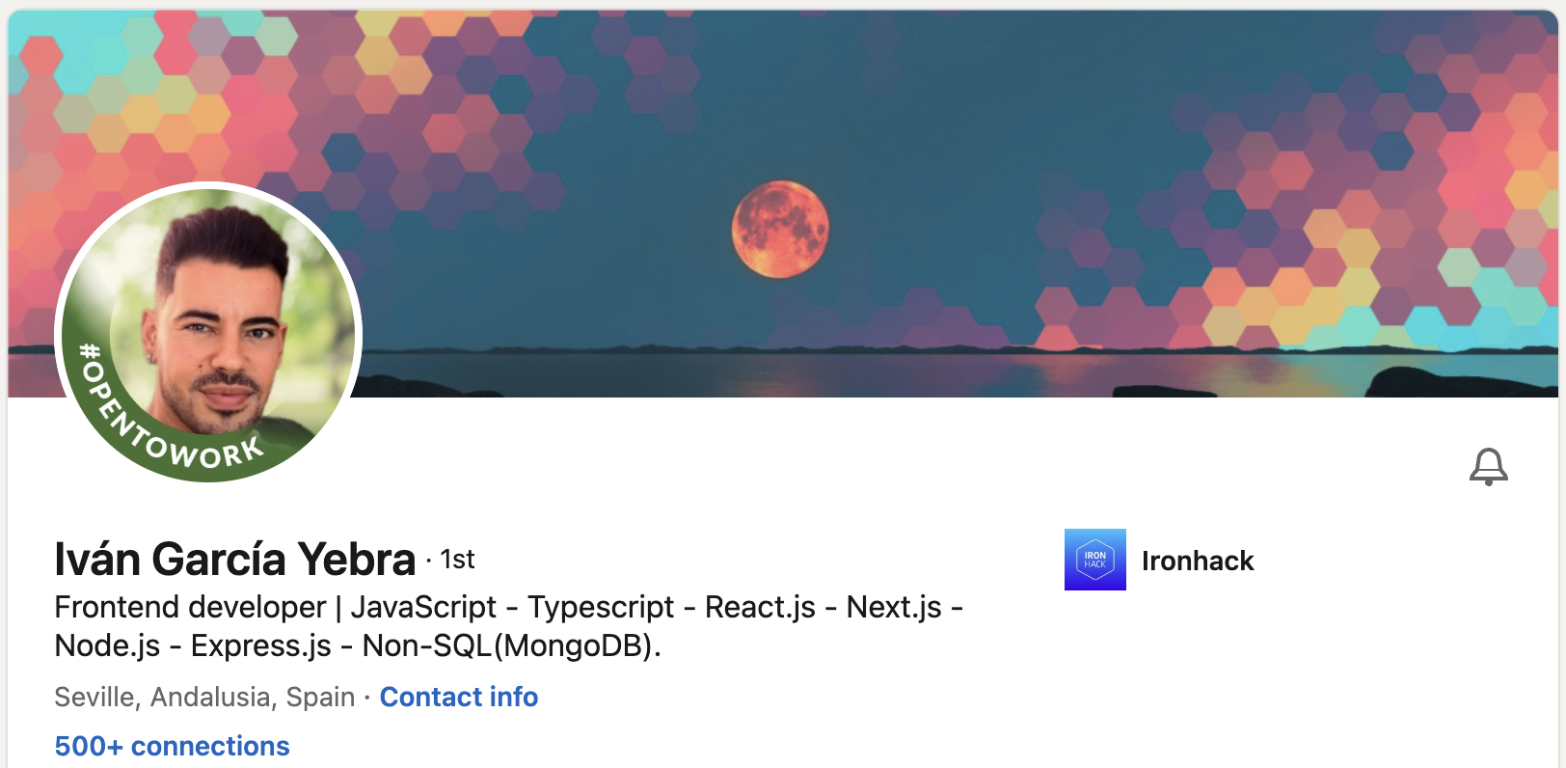
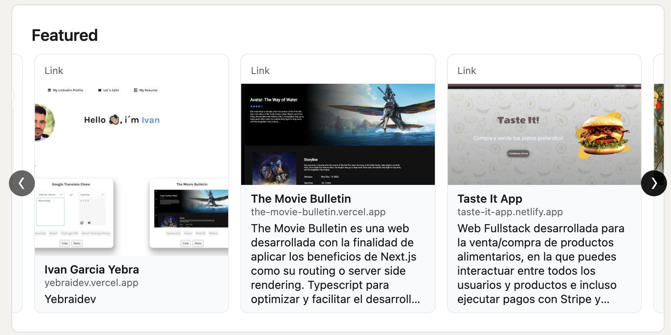
Notes:
Here’s an example of one of our fellow Ironhackers, Ivan - who used the Featured section to showcase his many projects - not only those he worked on during the bootcamp, but also all the new ones he continues doing during his job search. It’s essentially a section where you can display different types of media, such as links, images, documents, and videos in carousel mode to your profile and pin it there to make it one of the first things to be seen when someone comes to visit your page. So, as a junior tech candidate - this is a must for you to show people your technical projects and achievements and demonstrate tangible proof of your tech skills.
We can’t wait to see your projects beautifully displayed on your profile!

Slide 18
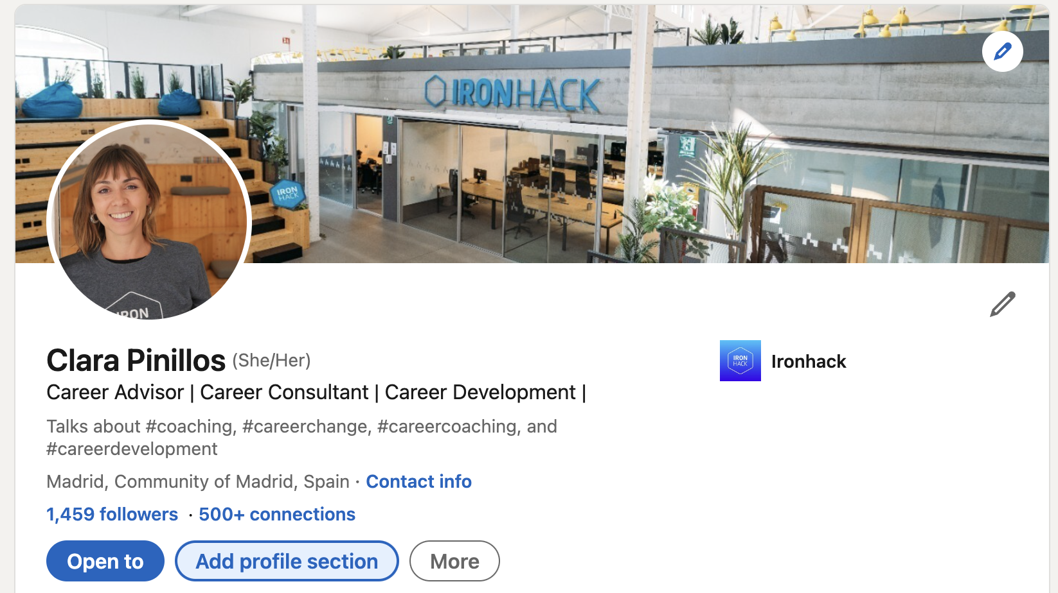
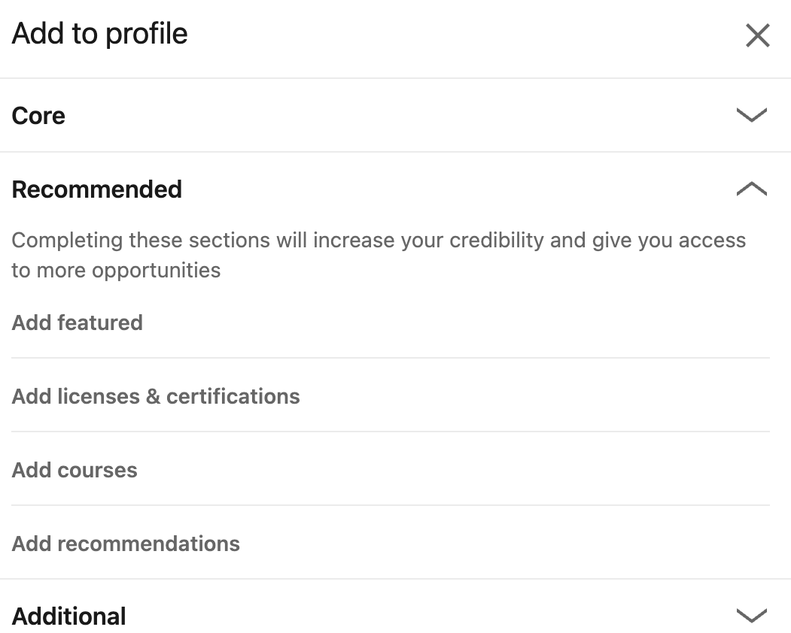
Notes:
Here is how you add it. Simply go to your public profile view, click on Add profile section and select the recommended option and choose Add Featured from the menu. Then, choose what you’d like to upload (the link to your Github, Behance, the demo site to each side of your projects, the PDF of your Ironhack certificate and so on).

Slide 19
THE EXPERIENCE SECTION
Your professional trajectory so far
IRONHACK 2023. ALL RIGHTS RESERVED.
Notes:
The professional experience section and some of the following ones, like Education and Skills - will be very similar to what we discussed on the CV workshop so feel free to go back to those slides in your Careerhack content any time if you wish to polish this part of your LinkedIn profile.

Slide 20
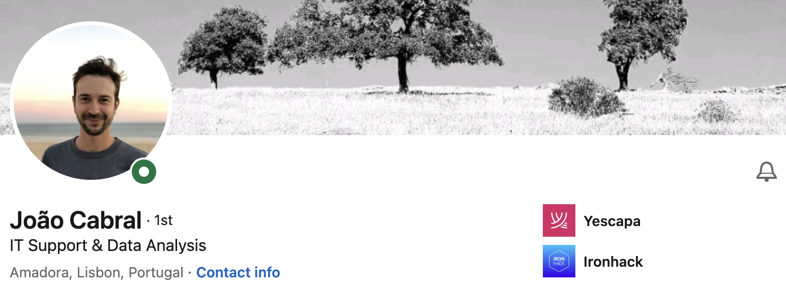
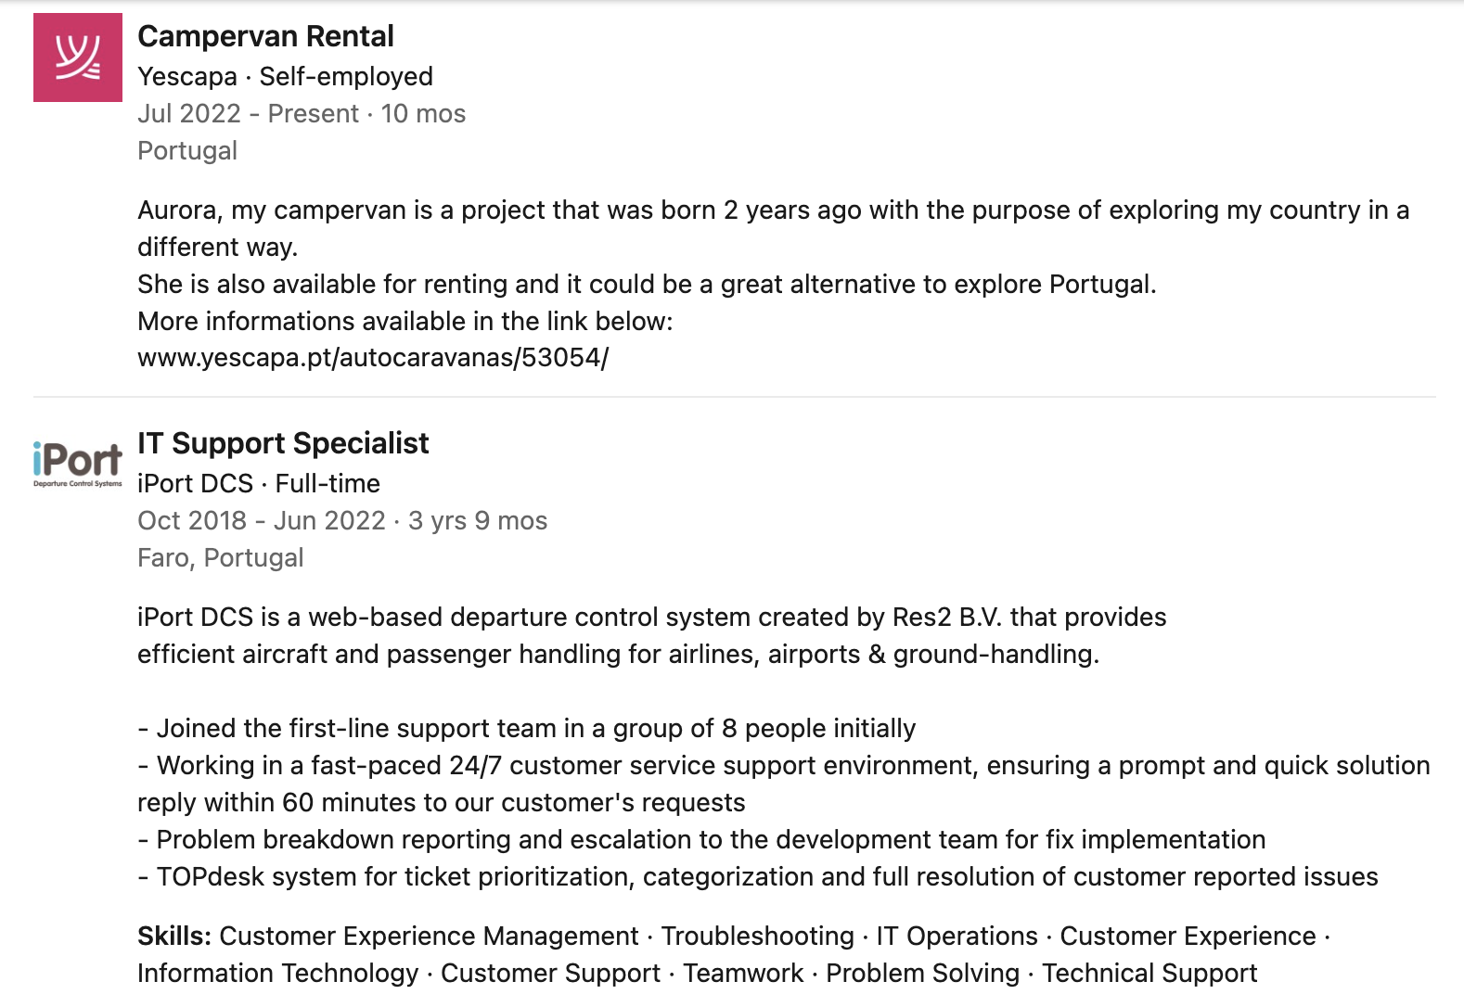
Find the connecting dots between your old roles and your future one
Clear job title
Be short and concise
Bullet points or short sentences
Facts & Figures
Relevant skills
Company name and job description
Notes:
One question you may be asking yourself is - why would recruiters care about my previous experience if it wasn’t related to my new career goal or field of study? Well, companies don’t only look at technical skills but also at other transferable skills. At the end of the day, organizations are made of people and interpersonal skills and other non-technical skills are key to make teams work harmoniously together to achieve business goals. Don’t underestimate any previous experience - but make sure you think how you want to describe it - always keeping in mind the same parameter: recruiters literally have seconds to look at your profile - so focus on the ESSENTIAL pieces and be short and concise. Again, feel free to use bullet points if it’s easier for you and whenever possible, try to think on the connecting dots between that professional experience and your new role in tech. I encourage you to research common skills. So, looking at the professional experience section of João’s profile, there are a few things that you can learn from the way he structured his profile.
Start with a clear job title: Joao's job title for each experience is easily identifiable and specific.
He uses bullet points to list responsibilities and achievements: to clearly and concisely list his responsibilities and achievements for each position he has held.
He’s also used facts and figures - and people love those! We talked about it in the CV workshop too. Joao includes quantifiable achievements, such as increasing efficiency by a certain percentage, to give potential employers a clear idea of his impact in previous roles. Try to do something similar by mentioning how many projects you oversaw, how many customers you helped and so on.
He also highlighted relevant skills that he utilized in each position, which is especially important for you as recent tech graduate who may not have a lot of professional experience. Remember that it’s recommended for you to read job descriptions of your target roles as developers, analysts and designers and identify so called soft skills or professional skills and try to incorporate these as keywords in your professional experience descriptions too!
Lastly, he included company and job descriptions which gives context to his experience. Oh, and remember - you own your LinkedIn profile - so feel free to, on top of all this, add any other information you value, may that be a personal reflection of what you learned during your time at that company or add a media file such as a picture of you and your team to reflect how well you got along with the people working there.

Slide 21
THE EDUCATION SECTION
Ironhack at the center
IRONHACK 2023. ALL RIGHTS RESERVED.
Notes:
At this point in time, and especially after you graduate from your bootcamp - Ironhack and your projects will be the core of your “Career Capital”. It is literally the only related experience you have in the field of programming, design or analytics - so we need to make sure that you squeeze that lemon as much as possible!

Slide 22
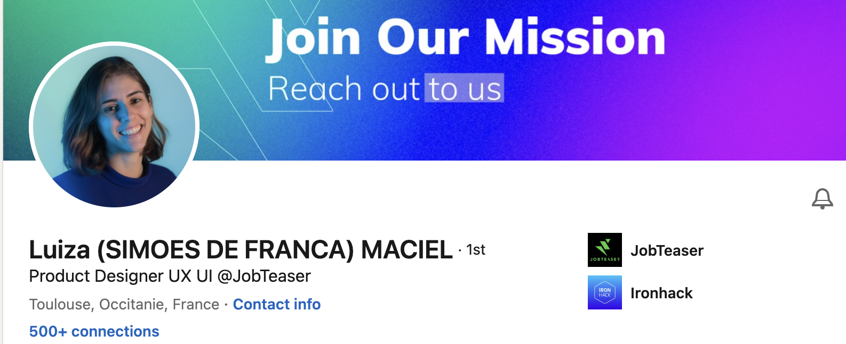
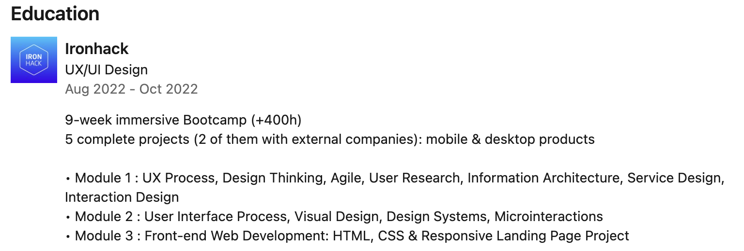
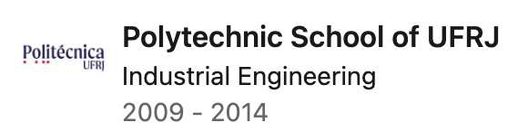
Ironhack: your validation proof for your technical preparation
Describe the structure
Focus on the content (use industry keywords!)
Facts & figures
Bootcamp’s length, number of hours, projects, etc.
Number of projects done
Add previous education too
Only highest education (no need for high school, etc.)
Additional tech certificates (i.e. Udemy) go in a different section
Notes:
Here are some tips and information to help you write a strong education section: Of course, describe your Ironhack bootcamp as the jewel in the crown of your education.
Just like in the example shown on the slide - make sure to describe the overall structure of your bootcamp as well as the content of the different modules, the topics studied, etc.) - and once again, type your keywords again!!!!!
Also, add the number of hours - the official and unofficial ones too! Remember how many hours you stayed after class working on your projects and make sure that is represented there to provide more credibility to your technical preparation.
And of course how many projects you worked on.
Furthermore, add all relevant education you may have done previous to Ironhack, even if unrelated to the tech industry. Just make sure to only add your highest degrees or certificates - may that be a professional certification, a “university, masters” and skip your high school or A-levels. No need to add this. But of course if you have any special recognitions or academic achievements that stand out - don’t dare to forget them! At the end of the day, it’s a brilliant way to let the world know your value!!! So feel free to add any honors and awards or scholarships during your education.

Slide 23
THE SKILLS SECTION
Show credibility
IRONHACK 2023. ALL RIGHTS RESERVED.
Notes:
Moving on to the skills section now.
The Skills section on LinkedIn is a critical component of your profile as it showcases your professional abilities and areas of expertise. Including relevant skills can increase your visibility whenever someone searches for candidates and therefore make it easier for recruiters and hiring managers to find you.

Slide 24
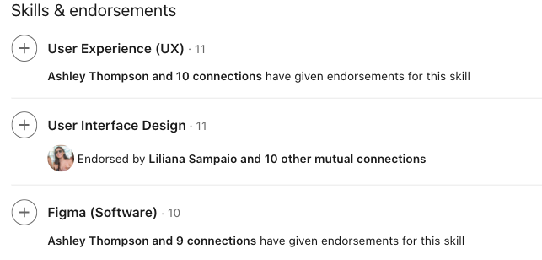
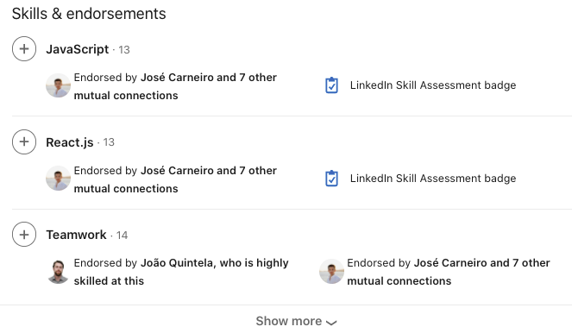
Try to fit everything into one page
Focus on the most relevant information
Remember that your CV will be in constant change and evolution
Your Ironhack SSM will help you out!
Important to keep in mind
Include your new tech skills
Include relevant soft skills
Use LinkedIn suggestions
Prioritize your top 3
Endorse each other!
Notes:
You will find the skills section right after your Education section and here are some reliable recommendations to optimize it:
Include relevant skills: Make sure to include the skills that are most relevant to your industry and the type of job you are seeking. This could include hard skills, such as coding languages, or soft skills, such as communication or leadership.
Use LinkedIn's suggestions: LinkedIn provides suggestions for skills based on your industry and job title. Review these suggestions and add the ones that are most relevant to you.
Prioritize your top skills: You can rearrange the order of your skills to prioritize your most important and relevant ones. Simply click and drag the skills to move them around - and remember that it’s not about having 50+ skills there - it’s about truly reflecting and focusing on your strengths and the skills you are currently developing.
Get endorsed: Endorsements are a social validation tool so that other people that have worked with you directly can testify and validate your skills and expertise. So, benefit from your new network of fellow Ironhackers in your cohort and all over to endorse each other! You can ask your LT’s, TA’s, PM’s and SSM too - and of course for other skills you can use your wider network of former colleagues too! Lastly, one really interesting feature on this section is that you can take short quizzes on LinkedIn to test your skills on specific topics and gain badges that will be displayed in your profile!

Slide 25
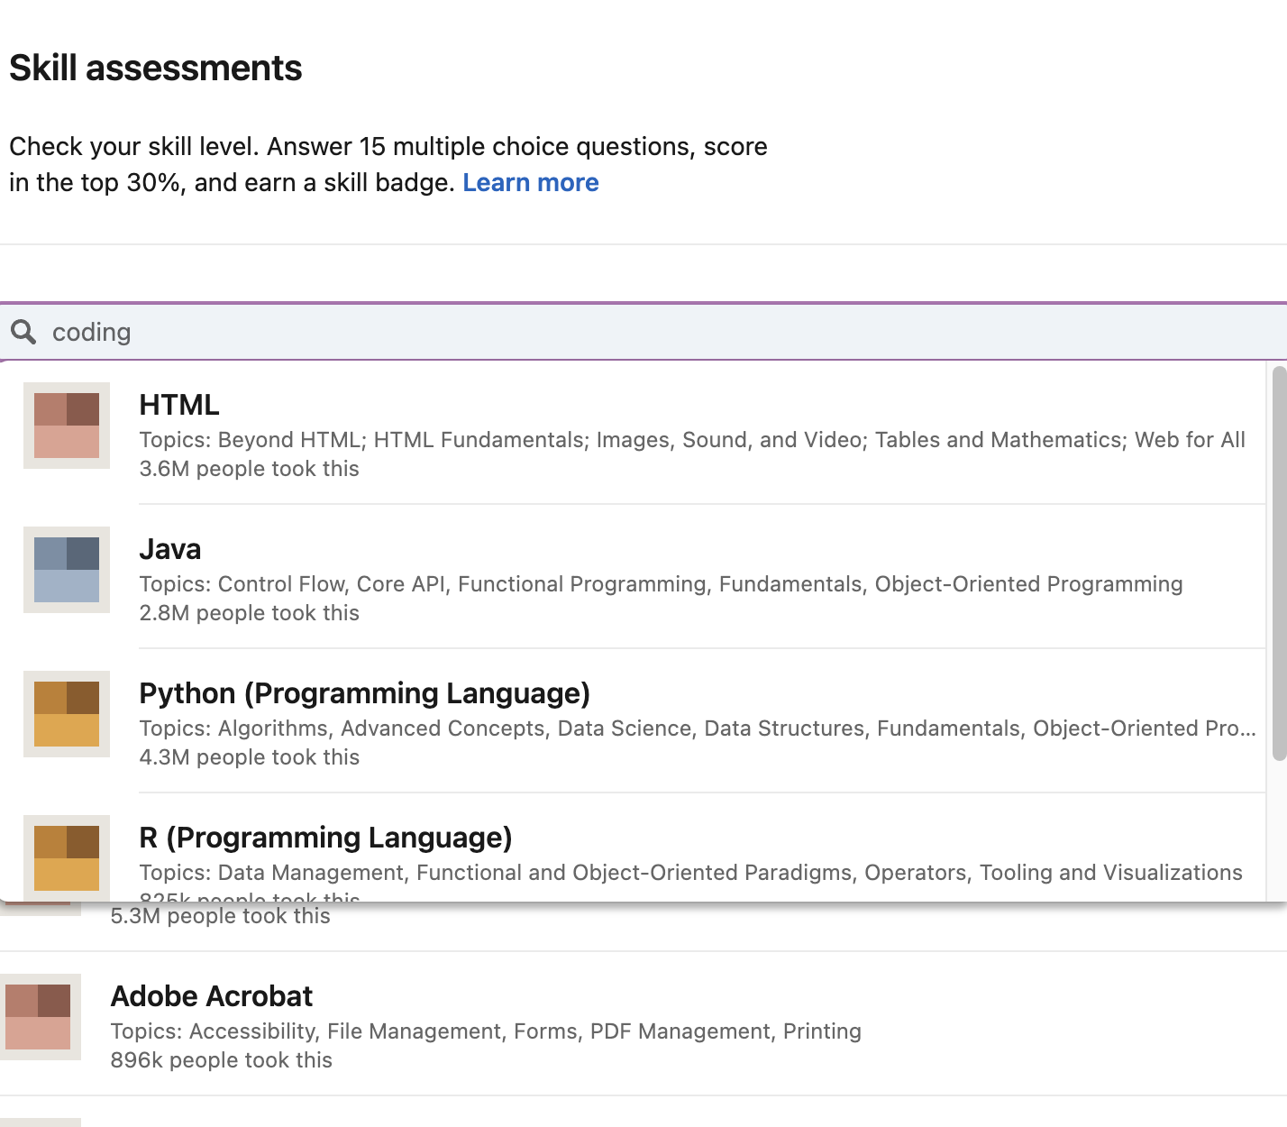
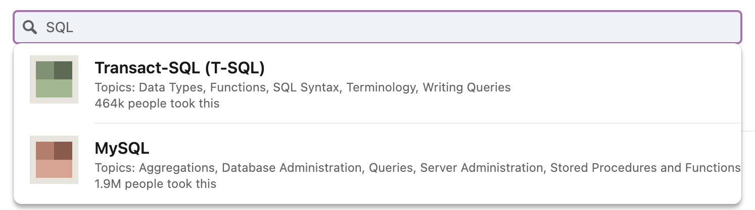
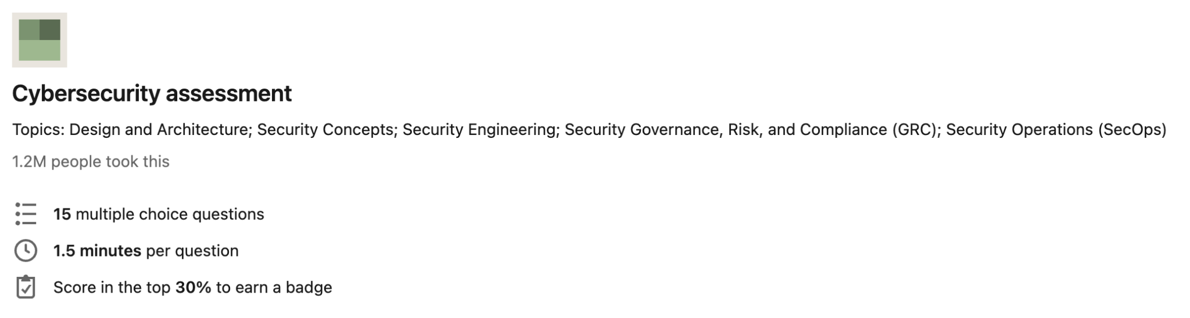
Validate your skills
Check out skills assessments in your field
Take the tests
Own badges
Post about it!
Notes:
The LinkedIn Skills Assessments is a feature that allows you to demonstrate your proficiency in a specific skill by taking a timed multiple-choice test providing a score that can appear on your profile for others to see.
Skills Assessments are available for a variety of skills, including technical skills like coding, data analysis, and digital marketing, as well as soft skills like communication, leadership, and time management, and are developed in partnership with industry experts. LinkedIn offers Skill Badges, which can be earned by achieving a score of 70% or higher on a Skills Assessment. Skill Badges will then be displayed on your profile, indicating to employers and other LinkedIn users that you have demonstrated proficiency in a particular skill!
Beware that this feature is not available for all skills and industries, and that the results of the assessments may not be a perfect representation of your abilities in a particular skill. However, they can be a valuable tool for you as a job seeker looking to demonstrate your skills and knowledge to potential employers.

Slide 26
ADDITIONAL SECTIONS
Small details matter
IRONHACK 2023. ALL RIGHTS RESERVED.
Notes:
As a social, professional network - LinkedIn is in constant evolution and you will find regular updates and new features to the profile and the overall experience - so I highly encourage you to spend some time exploring the tool, the different options, sections, settings and read about best practices if you really really want to take advantage of everything it offers.
In other episodes we will be discussing other more advanced features or best practices such as networking or job seeker best practices - but before we get into that, let’s wrap up the LinkedIn profile module with some additional sections and tips that you should not dismiss!

Slide 27
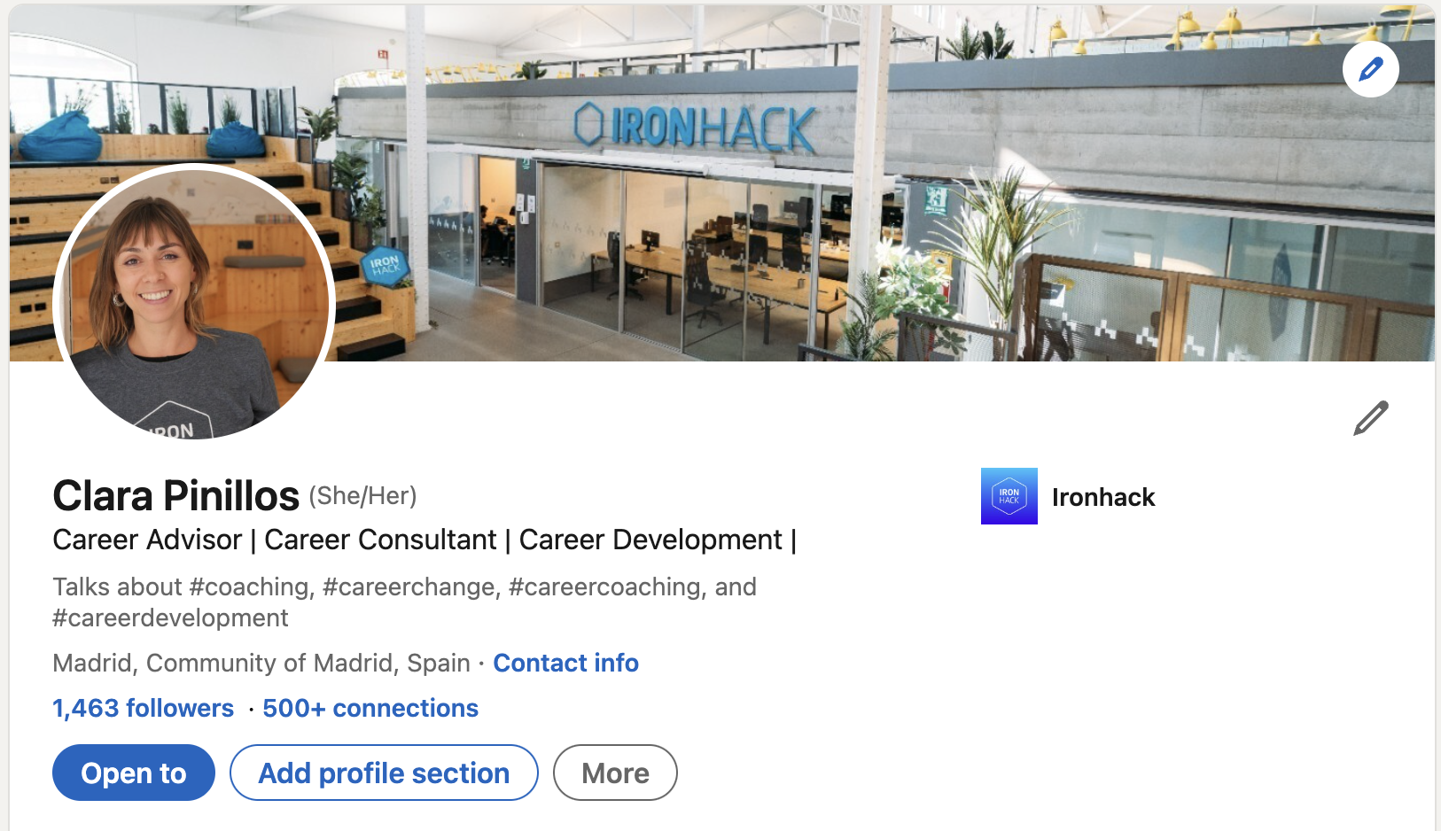
Your location & network
Specify your location
If you live in a very small town - consider adding the next biggest town
Add your availability for remote working in your job seeker settings or specify it in your ‘About Me’
Invest time in growing your network
Size and quality matters!
Connecting vs Following
Connect with a purpose
Nourish relationships by engaging
Notes:
Firstly, specify your location. If you live in a very small town, consider choosing the next biggest town instead as your location on LinkedIn. This can not only help you connect with more people, but also, increase your chances of being considered or reached out for job opportunities. Even though remote working is growing in general, it’s not so common for junior talent which means that being physically near the office for at least a flexible or hybrid mode can make a huge difference for recruiters to take you into account or approach you in the first place. But still, if you are open to remote work, you can edit your job seeker settings but also specify it in your 'About Me' section.
Invest time in growing your network. The size and quality of your network matter! The whole user experience on LinkedIn changes depending on the quality of your network - so if you add random individuals or say friends from high school like you’d do on Facebook or Instagram, you will see irrelevant content! Instead make sure to invest time in adding people that share common professional goals, through leaders, recruiters or companies of your interest so that the content you consume on the platform can support your goal of progressing in the tech sector.
Remember, there's a difference between connecting and following. You don’t need to connect with absolutely everyone you see out there. If you have something in common or feel like there could be a potential synergy between the two of you - connect with them by sending a brief message, but if you only want to follow that person but have no particular reason to connect, you can also use the Follow option. But don’t worry, we’ll talk more about LinkedIn networking in another workshop.
Lastly, remember to nourish and strengthen your relationships by engaging with your connections. This can be as easy as engaging in conversations through comments, likes, shares or reactions to their posts. This can help keep you top of mind when they come across job opportunities that match your skills and experience.

Slide 28
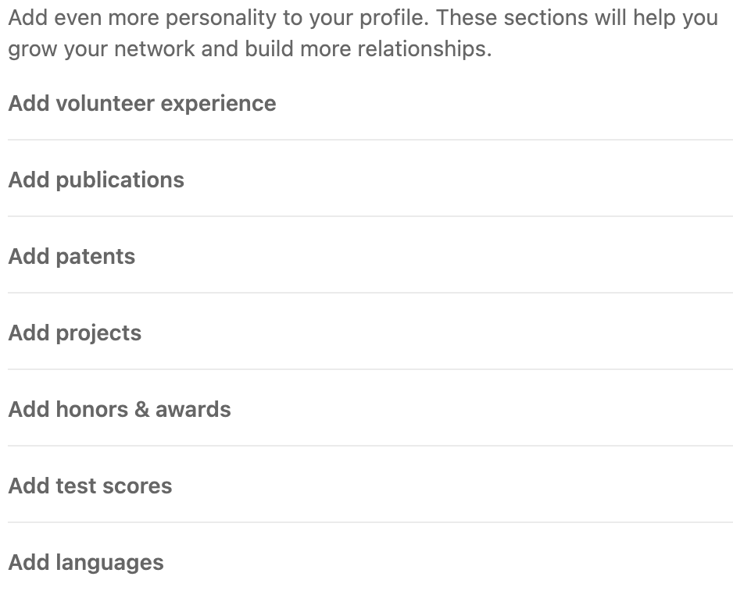
Review ‘Recommended’ and ‘Additional’ sections
I.e. Languages
Projects
Volunteering
Courses
Honors & Awards, etc.
Notes:
If you go to your public profile - one of the most first settings you should start exploring is the “Add profile section”. You’ll see that there are 3 main sections - the core one (which includes your professional experience, education and skills) that we just covered, and then a recommended and an additional section with several subsections. As their name suggests, they are complementary to the core ones but can add a lot of added value to your profile. Our preferred sections are languages (so if you speak any other language aside from your mother tongue - this is especially important if you live in a foreign country, as some companies do need you to speak the local language), your projects - where you can describe each and every project separately and include media and links, volunteering (if you’ve volunteered for a charity before or if you’ve offered your services for free to, for example, help a friend build a website). Also the courses section that I mentioned previously - this would be perfect for you to add any top up or short courses you do after the bootcamp on Udemy and so on, and the Honors & awards section.
By spending time completing these sections, you will be demonstrating that you’ve invested time and effort to truly craft a compelling profile to share more about your personal, but most importantly, your professional talents and aspirations!
I hope you have found this workshop useful and that you feel ready to start working on your LinkedIn. Remember to follow your Careerhack instructions and complete your deliverables by the given deadline if you’d like to receive personalized feedback from your Career Services team.

Slide 29
Thanks!
IRONHACK 2023. ALL RIGHTS RESERVED.

